Slide 1

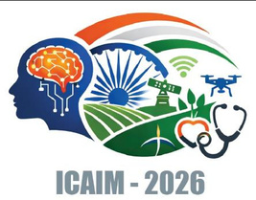

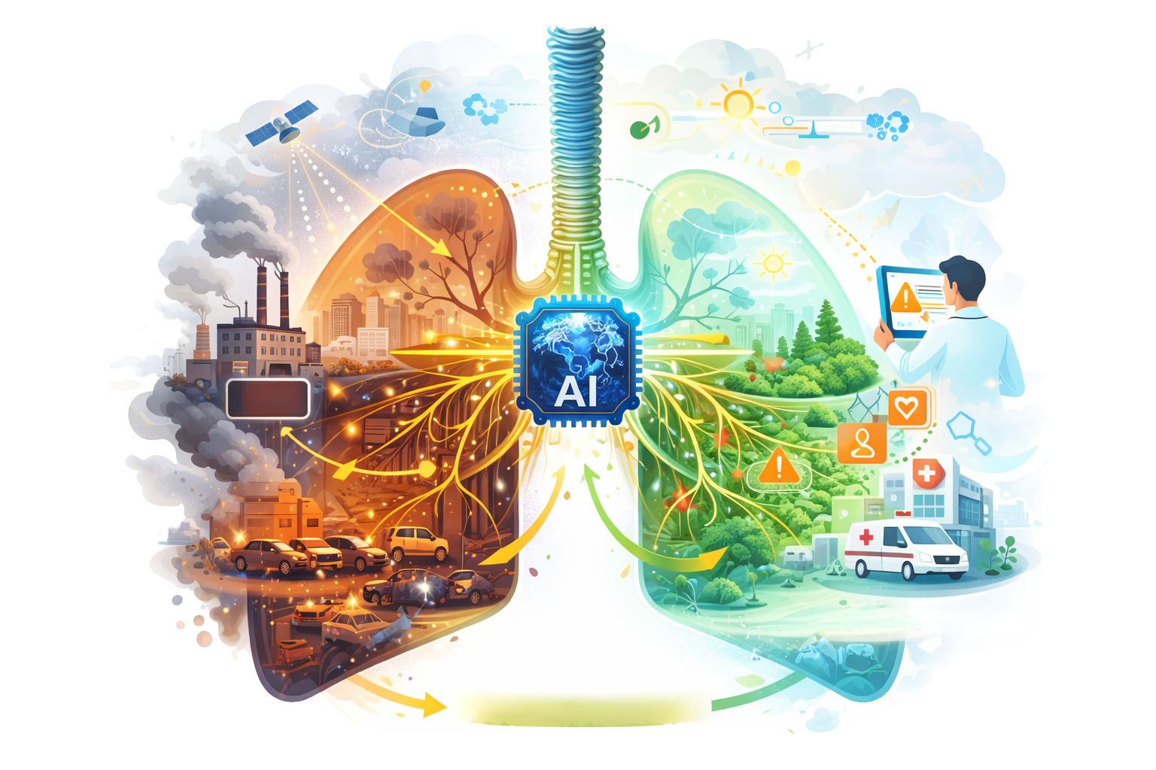
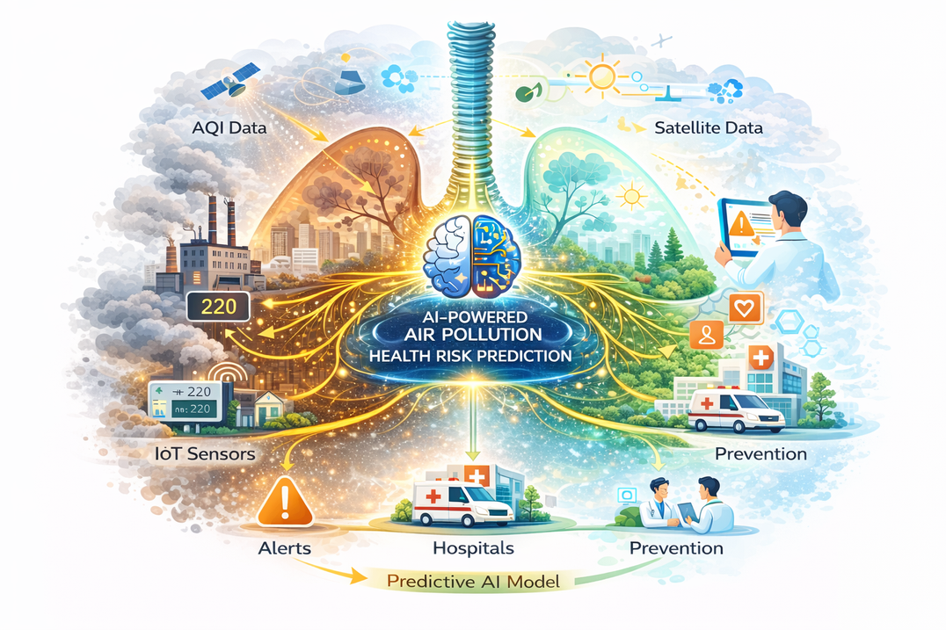
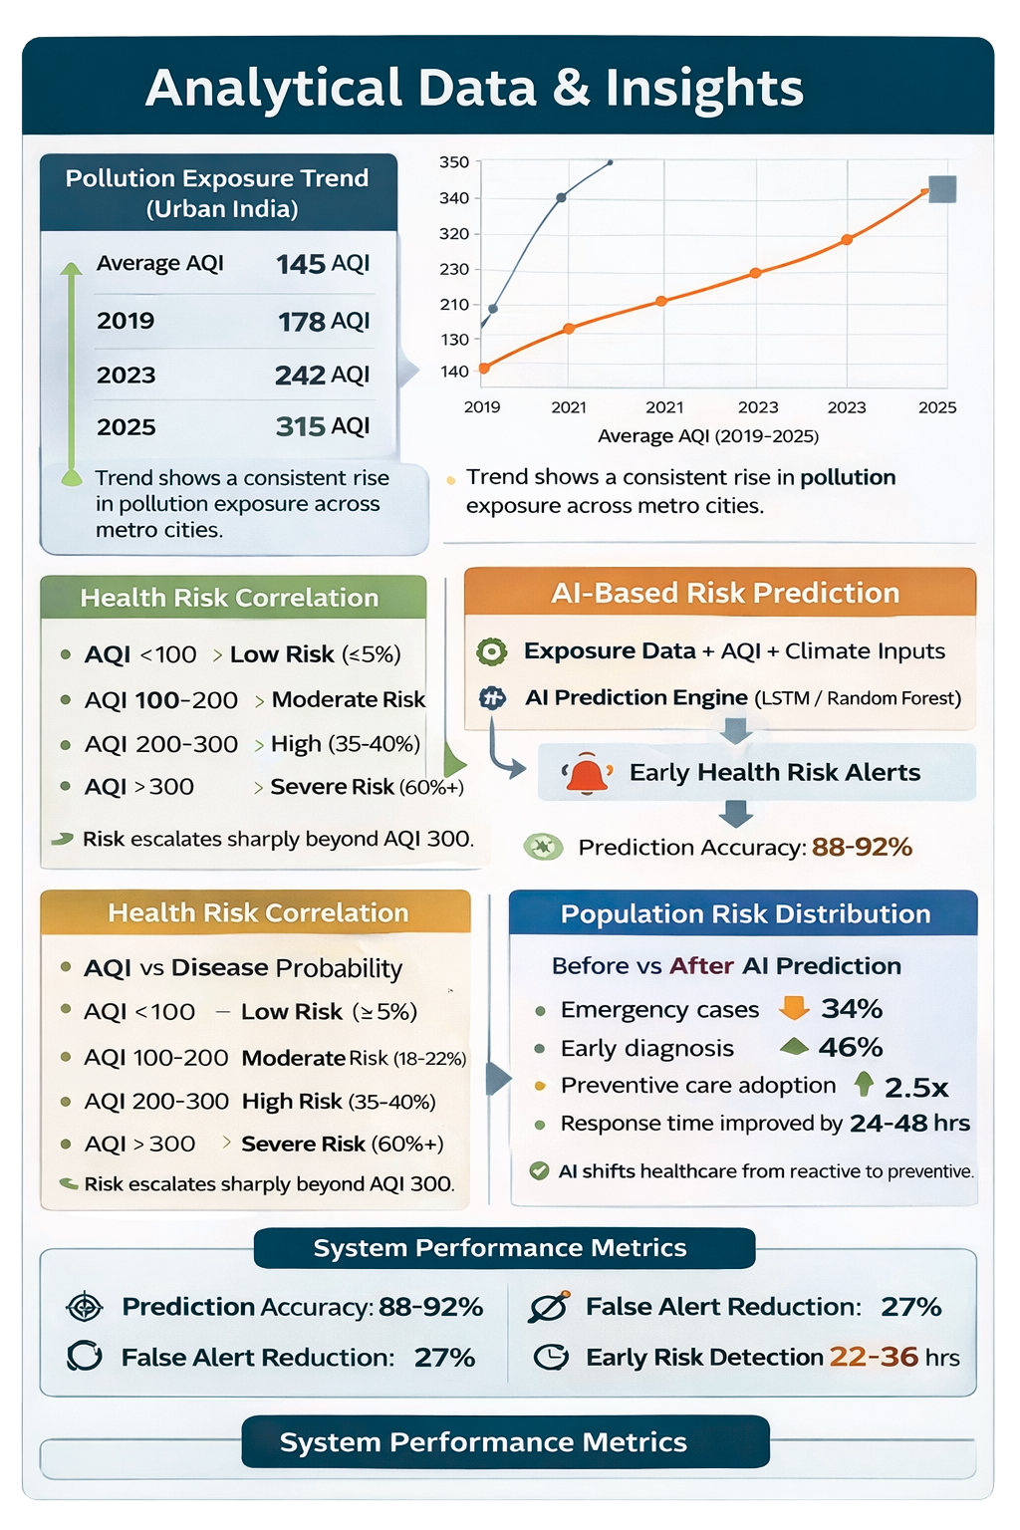
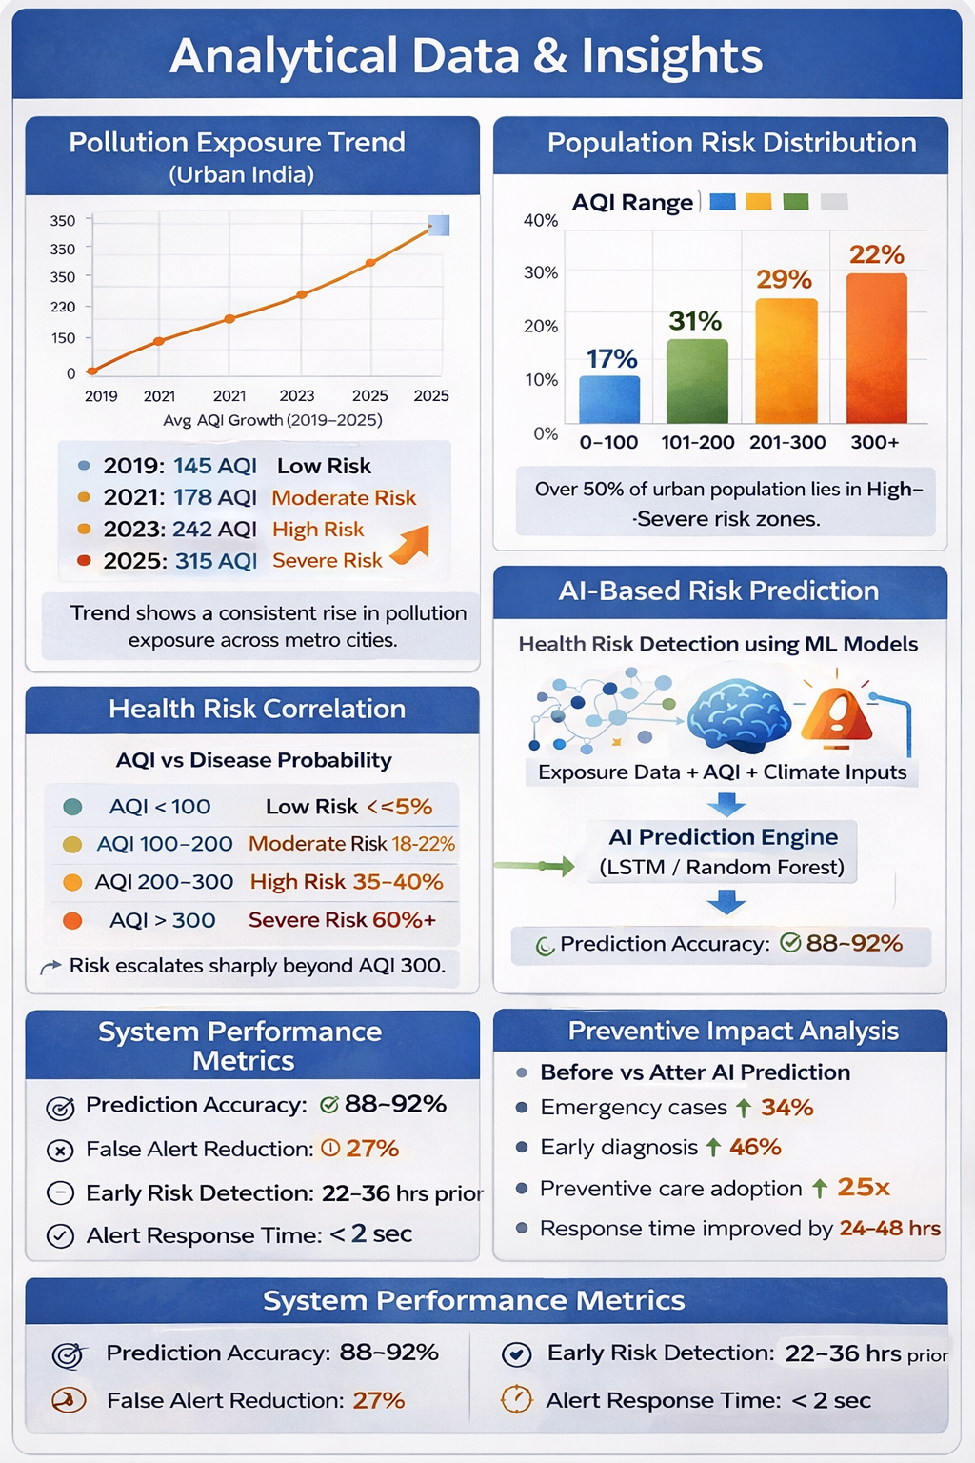
AI-Based Predictive Analytics for Pollution-Driven Health Risks in Bharat
“Empowering Bharat through Intelligent, Accessible & Affordable Healthcare”
Siddhesh Thombare (197) - Rohit Tiwari (201) - Shivam Tiwari (202) - Vishal Tiwari (203) - Omkar Tripathi (205)
Introduction
Problem Statement
Objectives
Environmental pollution has emerged as a major public health challenge in India, especially in metropolitan regions with persistently high Air Quality Index (AQI) levels. Continuous exposure to polluted air significantly increases the risk of respiratory, cardiovascular, and long-term chronic diseases. Despite advancements in healthcare, existing systems remain reactive, responding after symptoms appear. Integrating pollution monitoring with predictive analytics enables risk identification and supports preventive healthcare interventions.
India’s highly polluted metropolitan cities experience hazardous air quality levels where even routine breathing poses significant health risks. Large populations are increasingly dependent on air filtration and medical support to cope with chronic exposure. There is a lack of data-driven systems capable of quantitatively analyzing pollution exposure. This exposure accumulates subclinically over time, leading to severe respiratory and cardiovascular pathologies, demonstrating an imperative need for predictive and preventive healthcare solutions.
This study investigates pollution-related health risks in Indian metropolitan regions using integrated environmental data sources. An AI-based predictive analytics framework identifies early respiratory and cardiovascular risk levels. Air quality, climate, and exposure data are unified through the BAQIG platform for continuous analysis and forecasting. Real-time monitoring and intelligent alerts support preventive, data-driven healthcare planning.
Methods & Technology
Abstract
📡 Sensing : AQI sensors and weather stations capture real-time environmental data
🛰️ Remote Data : Satellite imagery provides large-scale pollution and climate patterns
🧠Intelligence : Machine learning models to analyze exposure patterns and predict health risks
🗂️ Integrated Platform: BAQIG unifies multi-source data
🗺️ Visualization : GIS based dashboard display regional health risk zones
📶 Monitoring : IoT-enabled systems ensure continuous real-time data flow and updates
Air pollution is a major public health challenge in India, especially in metropolitan cities. This study proposes an AI-driven framework that integrates air quality, climatic, satellite, and environmental data with the Bharat Air Quality Intelligence Grid (BAQIG) by predict pollution-related health risks and chronic conditions—before symptoms appear. By enabling warning, proactive risk assessment, and preventive interventions, the approach aims to reduce the long-term health impacts of chronic air pollution exposure.
References
World Health Organization (WHO). (2021). Air pollution and health. Retrieved from https://www.who.int
Central Pollution Control Board (CPCB). (2023). National air quality monitoring program. Retrieved from https://cpcb.nic.in
Shaddick, G. et al. (2018). Data integration for population exposure to air pollution. Environmental Science & Technology. Retrieved from https://pubs.acs.org/doi/10.1021/acs.est.8b02864
Balakrishnan, K. et al. (2019). Air Pollution and Health in India. World Bank Publications. Retrieved from https://openknowledge.worldbank.org
BAQIG – (2025). Air quality monitoring and analytics platform. By TIMSCDR

